Slide 1
Predicting suitable business type and location for new businesses in New Castle County, Delaware
Debasish Chaulia
12 June 2020

Slide 2
Predicting correct business type and location is important for new business
Everyone planning to set up a new business want/hope their business to be successful. In order for the new business to be successful, it must solve a problem, fulfill a need or offer something the market wants. There might be multiple options of new businesses in terms of type and location, but it’s very important to have better understanding and clear knowledge about the suitable business type and location we are selecting, so that it maximizes overall ROI (return on investment) and profit. And this selection might also help for the smooth operation of the business.

Slide 3
Data acquisition, cleaning and wrangling
ZIP Code Database from USPS (United States postal service) having all USA county wise details in it.
It is having information for all the states, I will filter out for Delaware based on state code ‘DE’
It is having 14 features in all, out of which I will select only (“County”, “Primary_City”, ”Latitude”, “Longitude”) based on the requirement
Check if there any null values in the dataset and do clean up
Perform exploratory data analysis on the dataset to see the main characteristics or summarization of the dataset
Select only those records from the cleanup dataset which corresponds to “New Castle County”

Slide 4
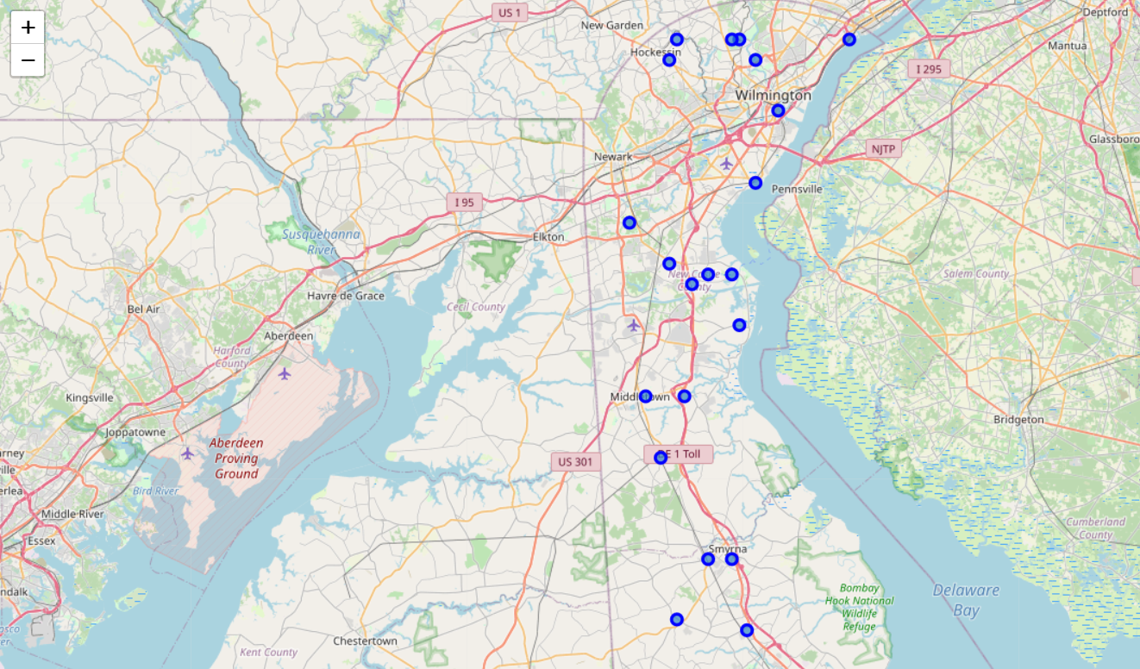
Data visualization
Plot a graph to visualize all New Castle county neighborhoods.

Slide 5
Methodology
Perform analytics on all of the New castle county neighborhoods.
Use foursquare API calls to get/explore all the venues of each of the neighborhoods of New Castle county
Result obtained from the call can then be used to find out what are the types of venues available for a neighborhood and reformatting them in a dataframe
Group rows by neighborhood and by taking the mean of the frequency of occurrence of each category
For each neighborhood, sort the venues based on mean frequency (ie descending order or most popular first) of the venue types

Slide 6
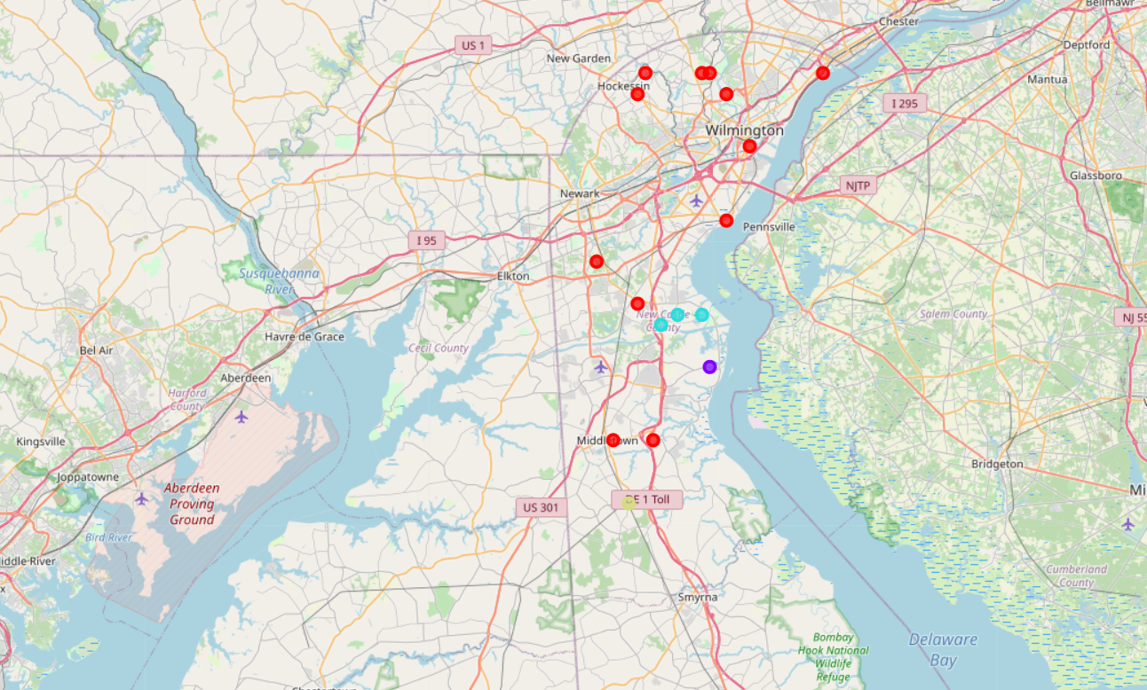
Results
Based on the 17 neighborhoods in New Castle county, we grouped these neighborhoods into 4 clusters based on the most common venues for the neighborhood.

Slide 7
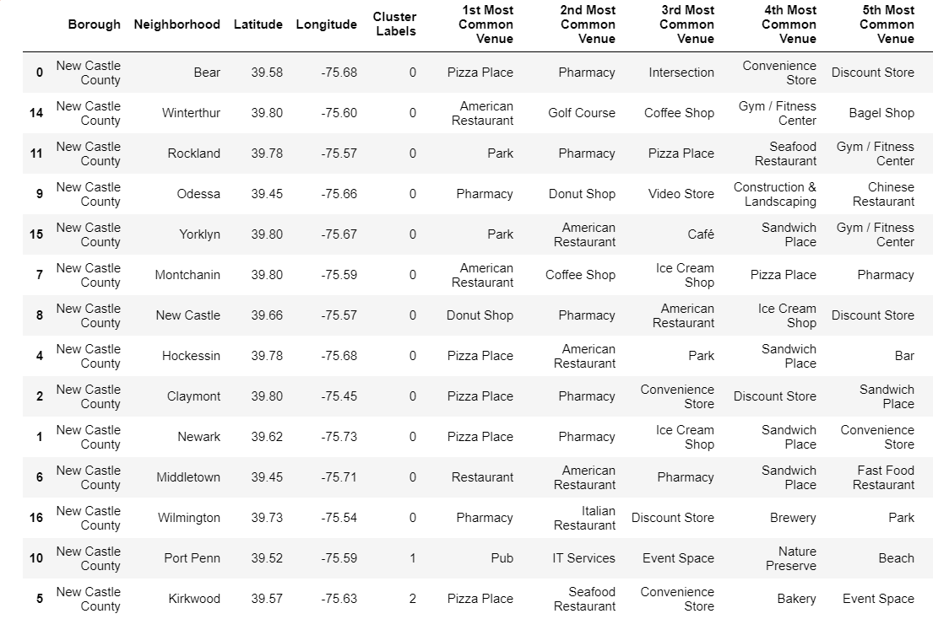
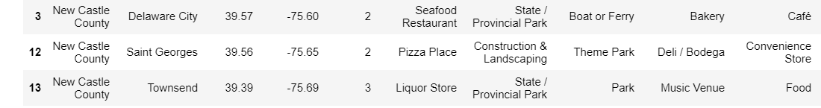
Results (Contd.)
Below dataframe shows cluster labels as well as top 5 venues for each neighborhood in New Castle county

Slide 8
Discussion (Selecting business location)
Based on the results obtained, one of the cluster 1 neighborhoods might be a good candidate for opening new businesses, as it shares lot of similarities in terms of most common venues with other neighborhoods in the same cluster 1.
Businesses can even potentially target customers residing in the vicinity of other neighborhoods also within same cluster.
Taking into consideration the importance of school district also, for people who planning to migrate to the New Castle, ‘Middletown’ turns out to be one of the optimum choice.

Slide 9
Discussion (Contd.) (Selecting business type)
Considering Middletown, 4 out of 5 most common venues in that neighborhood are already having eatery items(restaurants, fast food, sandwich etc), apparently looks to be overcrowded with restaurants
So possible choice could be something new in that neighborhood may be a gymnasium or gas station .
This option is bit risky as it is opting to deliver something other companies don’t
Other option might be to go with the type which is already a most common trend in that neighborhood (ie some kind of restaurant) , in that case risk is relatively less, but competition would be relatively high for this option and he would also need to keep in mind the principle (deliver the same thing, only faster and cheaper and better quality)

Slide 10
Conclusion
After thorough analysis of the results, we can possibly propose the below options:
a) opening a Gymnasium or gas station in Middletown, thereby opting to take more risk, and believing in the principle of delivering something other companies don't in that area. (High risk-reward ratio).
b) opening a type of business which is already a most common trend in Middletown neighborhood (ie some kind of restaurant), thereby opting to take less risk and believing in the principle of delivering the same thing, only faster, cheaper and better quality (Less risk-reward ratio).

Slide 11
Thank you

